Slide 1
AGILE BUSINESS INTELLIGENCE
Evan Leybourn
 | Starting with Agile Business Intelligence by Evan Leybourn is licensed under a Creative Commons Attribution-ShareAlike 3.0 Australia License <http://creativecommons.org/licenses/by-sa/3.0/au/>

Slide 2

Evan Leybourn lean / agile business leader and author
Singapore
@eleybourn http://theagiledirector.com
CLICK TO DISCOVER MORE

Slide 3
agile business intelligence part 1: introduction to agile

Slide 4
waterfall
To what degree is the outcome knowable in advance?
agile
To what degree is the outcome dependent on intangible elements?
To what degree can you coordinate and control all the players?

Slide 5
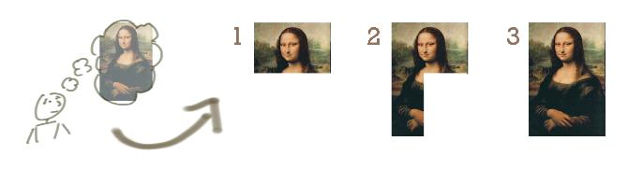
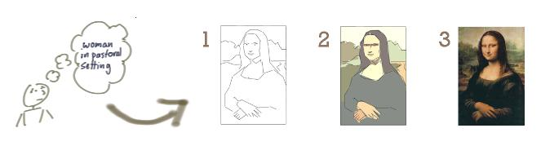
Waterfall (Incrementing)
Agile (Iterating)
Images with thanks from Jeff Patton: http://www.agileproductdesign.com/

Slide 6
individuals and interactions over processes and tools

Slide 7
working software over comprehensive documentation

Slide 8
customer collaboration over contract negotiation

Slide 9
responding to change over following a plan

Slide 10

our highest priority is to satisfy the customer through early and continuous delivery of valuable software.

Slide 11

welcome changing requirements, even late in development. agile processes harness change for the customer's competitive advantage.

Slide 12

deliver working software frequently, from a couple of weeks to a couple of months, with a preference to the shorter timescale.

Slide 13

business people and developers must work together daily throughout the project.

Slide 14

build projects around motivated individuals. give them the environment and support they need, and trust them to get the job done.

Slide 15

the most efficient and effective method of conveying information to and within a development team is face-to-face conversation.

Slide 16

working software is the primary measure of progress.

Slide 17
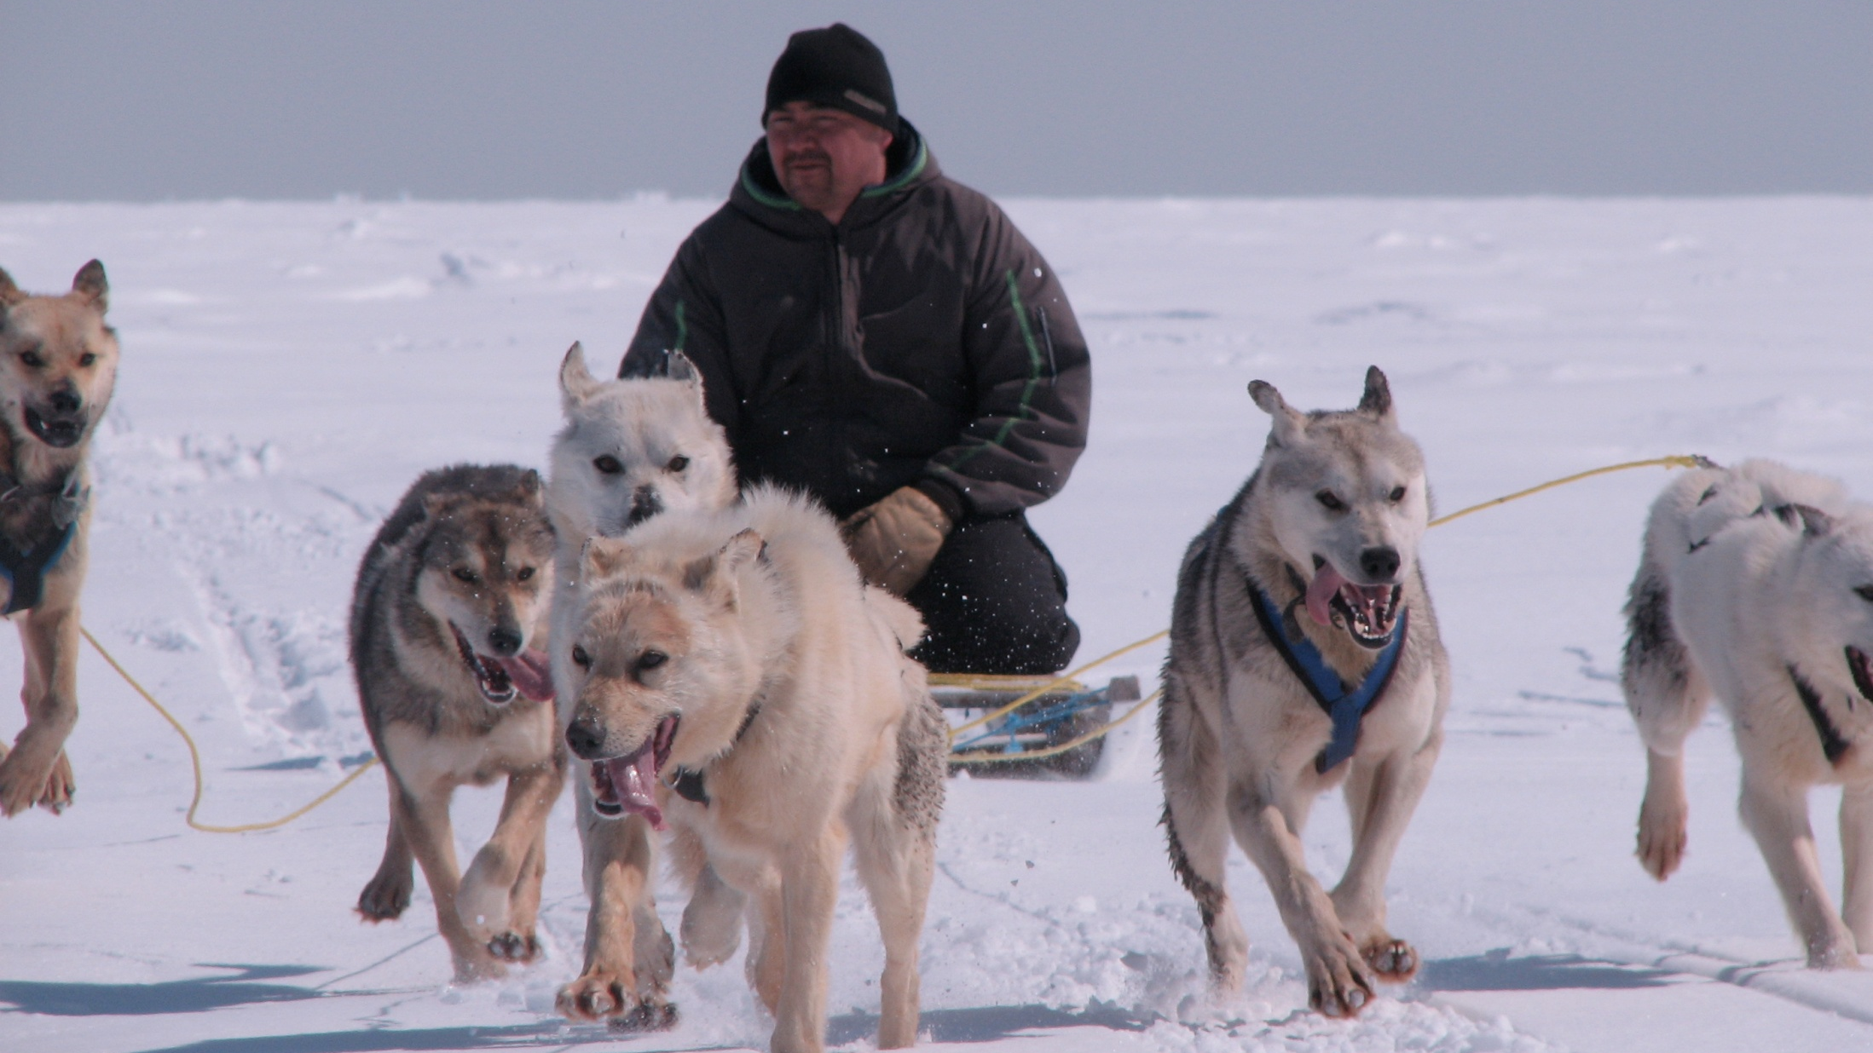
agile processes promote sustainable development. the sponsors, developers, and users should be able to maintain a constant pace indefinitely.

Slide 18

continuous attention to technical excellence and good design enhances agility.

Slide 19

simplicity--the art of maximizing the amount of work not done--is essential.

Slide 20

the best architectures, requirements, and designs emerge from self-organizing teams.

Slide 21

at regular intervals, the team reflects on how to become more effective, then tunes and adjusts its behaviour accordingly.

Slide 22
lean principles
1. eliminate waste

Slide 23
lean principles
2. amplify learning

Slide 24
lean principles
3. decide as late as possible

Slide 25
lean principles
4. deliver as fast as possible

Slide 26
lean principles
5. empower the team

Slide 27
lean principles
6. build integrity in

Slide 28
lean principles
7. see the whole

Slide 29
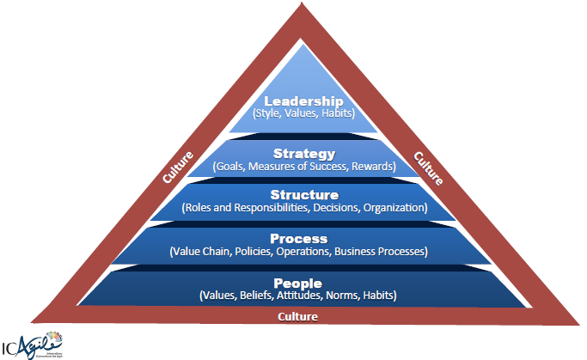
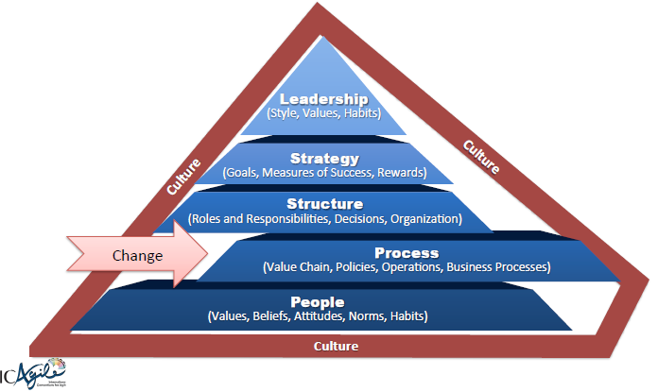
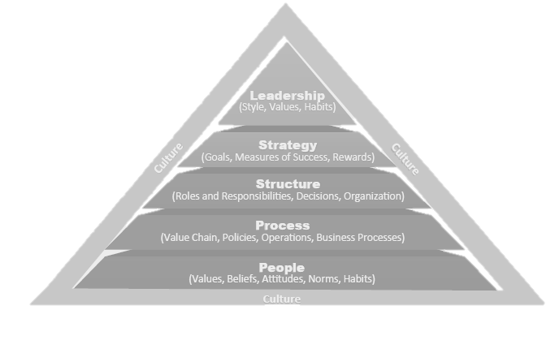
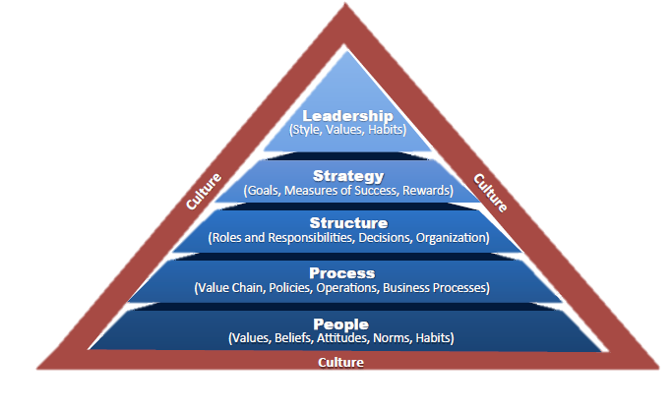
business change via sustained effort across the organisation
Change
Change
Change
Images shamelessly stolen from Ahmed Sidky (ICAgile)

Slide 30
Adaptive software development (ASD), Agile Business Management, Agile modelling, Agile Unified Process, Behaviour Driven Development (BDD), Crystal Clear, Disciplined agile delivery, Dynamic Systems Development Method (DSDM), Extreme Programming (XP), Feature Driven Development (FDD), Kanban, Lean Software Development, Rapid Application Development (RAD), IBM - Rational Unified Process (RUP), Scrum, Scrum-ban, Test Driven Development (TDD) and more…

Slide 31
mura: unevenness muri: overburden muda: waste understanding waste

Slide 32
the 7 wastes transport inventory motion waiting overproduction over processing defects

Slide 33

common agile mistakes agile means no documentation

Slide 34
common agile mistakes not measuring, monitoring or correcting

Slide 35
common agile mistakes assuming you can do more with less

Slide 36
common agile mistakes skimping on training and education

Slide 37
common agile mistakes lacking an executive sponsor

Slide 38
common agile mistakes thinking agile is faster or easy

Slide 39
common agile mistakes start with a tool

Slide 40
common agile mistakes failing to scale

Slide 41
common agile mistakes assuming agile = scrum

Slide 42
Business
Technical
Users
Customer
Customer Representative
Team Facilitator
Developers
Testers

Slide 43
7 +/- 2 typical team size

Slide 44
has an interest in the work & is kept up to date involved parties (chickens)

Slide 45
committed parties (pigs)
"do" the work & are responsible for the release

Slide 46
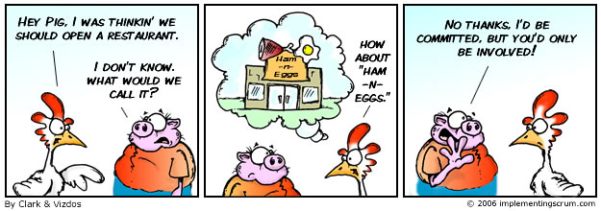

Slide 47
Evan Leybourn evan@theagiledirector.com questions???

Slide 48
agile business intelligence part 2: flow

Slide 49
Backlog
Build
Test
Done

Slide 50
Backlog
Build
Test
Done
Analysis
Stage
Doc’
Release

Slide 51
value stream mapping defines the ‘as-is’ steps & roles for each task

Slide 52
value added time spent on outcomes for the customer

Slide 53
non-value added time spent between steps

Slide 54
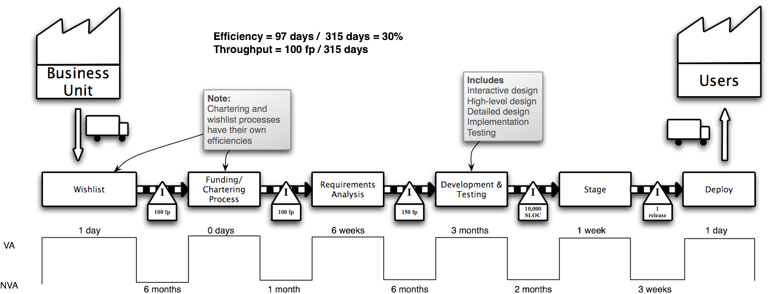
1. gather preliminary information
2. product quantity routing analysis
3. group customers and materials
4. sort product families by sequence
5. choose one value stream to start

Slide 55
6. create an operations flow chart
7. walk the shop floor
8. collect the data
9. construct the vsm
10. summarize the data to get the big picture

Slide 57
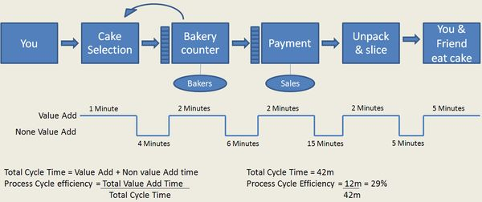

Slide 58
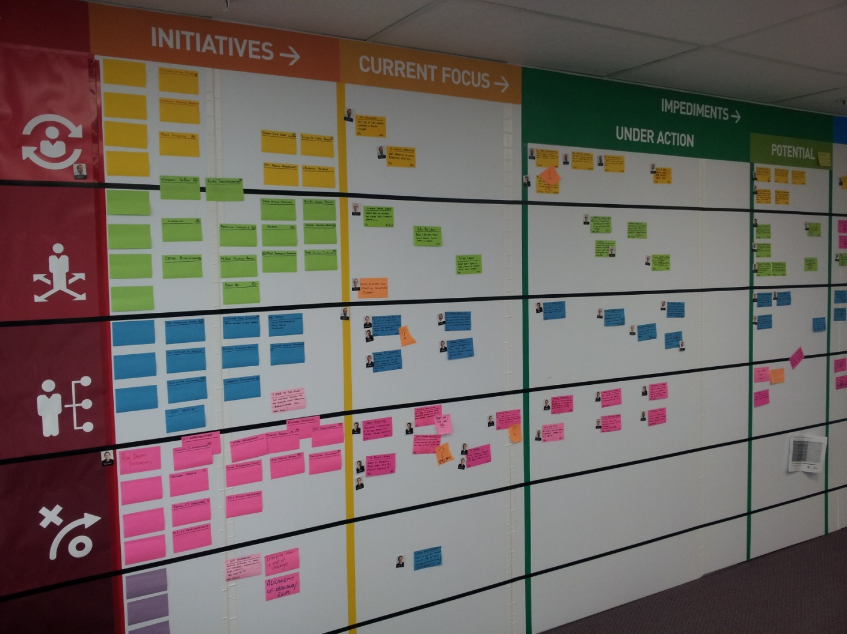
kanban (かんばん) workflow monitoring & visualisation

Slide 59
can be as simple or complex as required the flow of value through the system

Slide 60
work in progress limit concurrent work and promote workflow

Slide 61
“pull” all ready tasks to wip limit pull

Slide 62
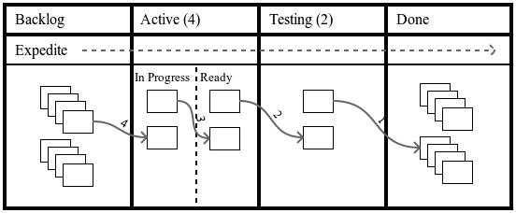

Slide 63
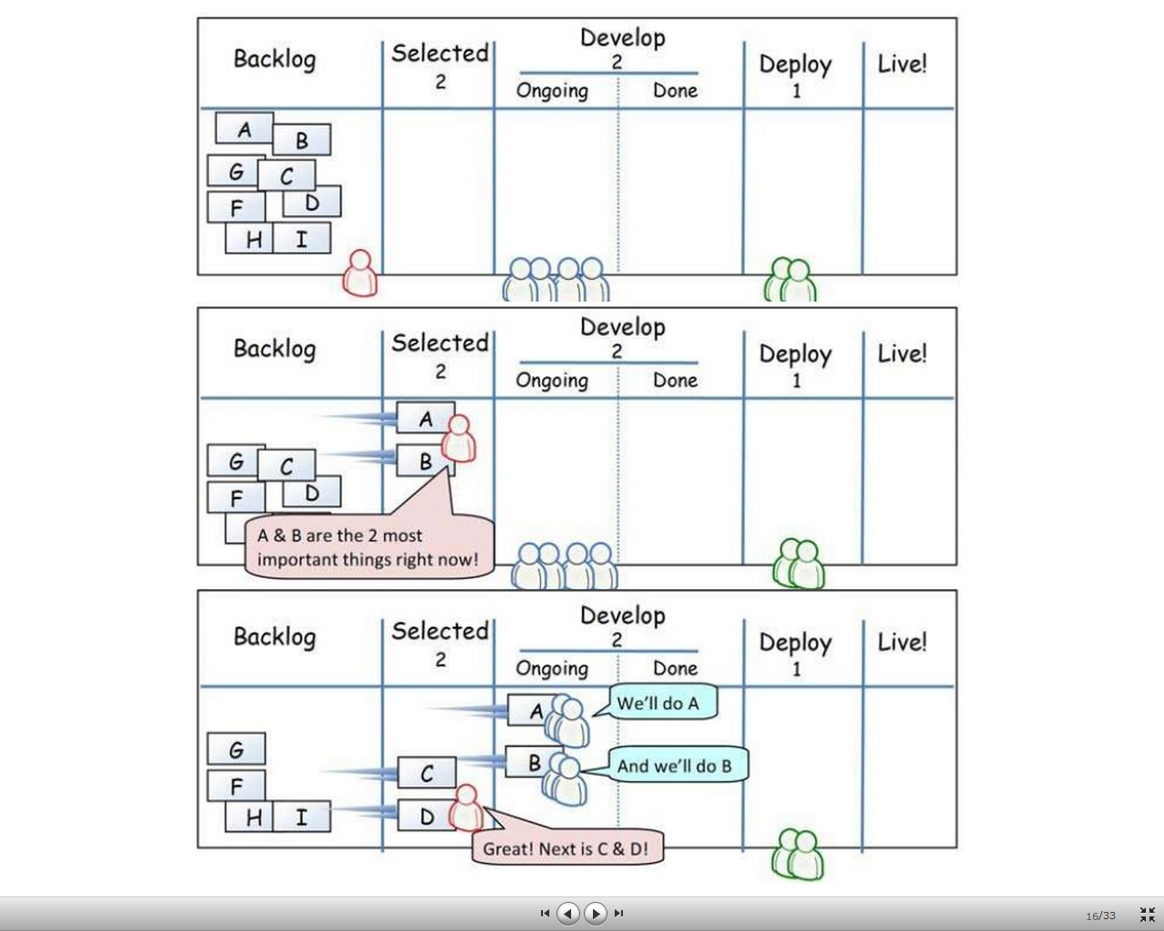

Slide 64
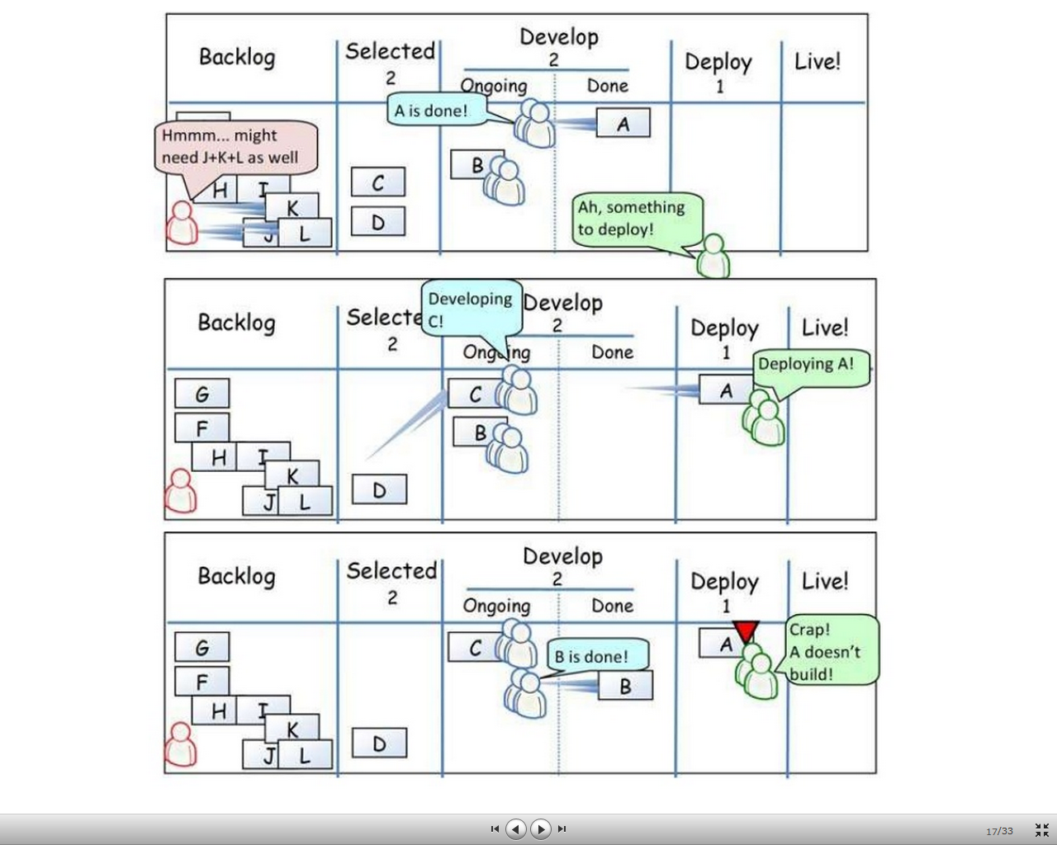

Slide 65
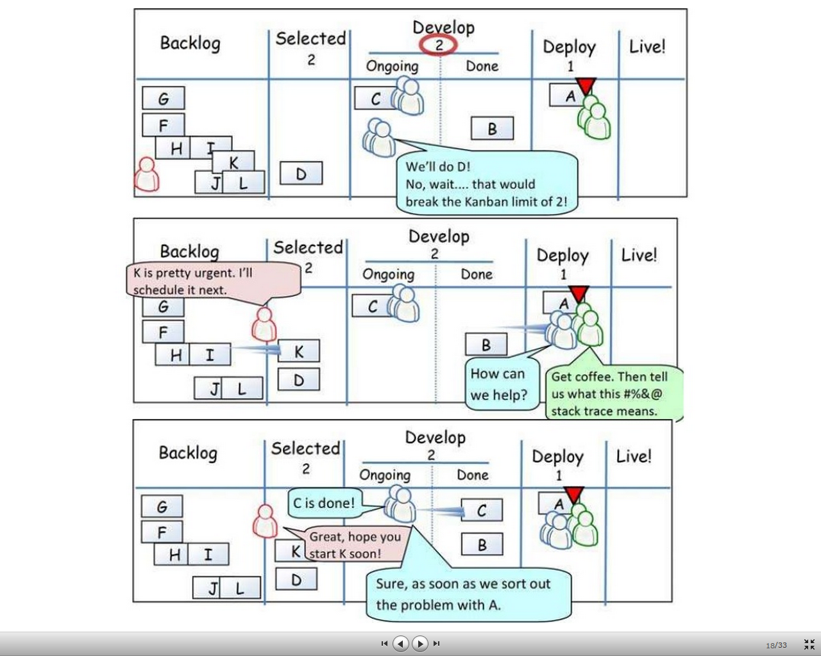

Slide 66
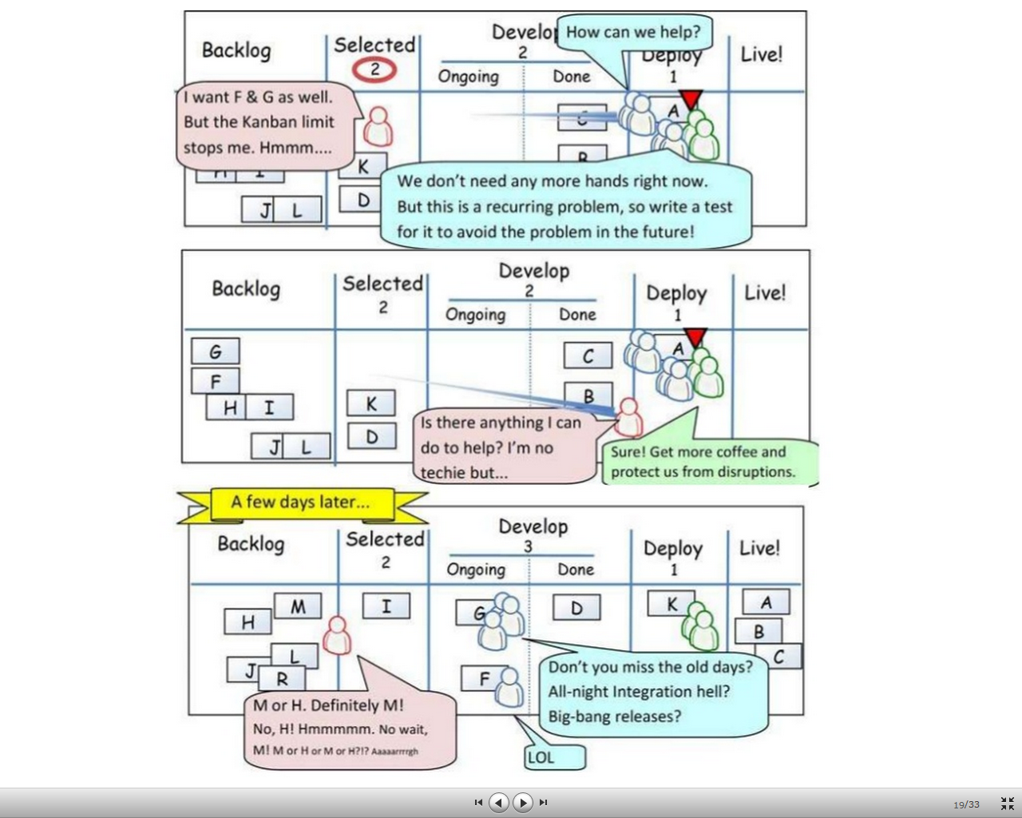

Slide 67
class of service expedite fixed delivery intangible class

Slide 68
tasks with upstream dependencies blocked

Slide 69
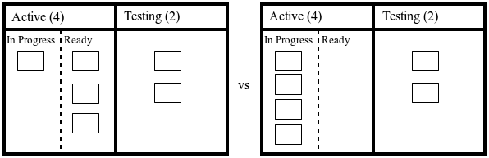

Slide 70
identify & resolve bottlenecks through low wip limits and strict process flow

Slide 71
production levelling constant rate of flow through all states

Slide 72
cycle time average time to complete a task from start

Slide 73
lead time average time to complete a task from request

Slide 74
progress monitoring cumulative flow diagram statistical run chart burndown/up chart

Slide 75
plot delivered functionality against duration effort visualisation

Slide 76
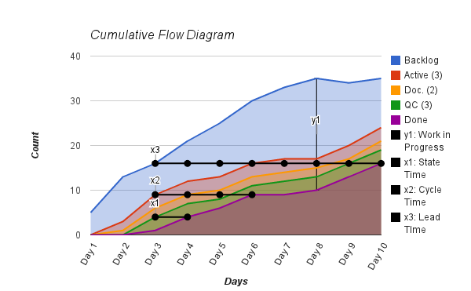
cumulative flow diagram

Slide 77
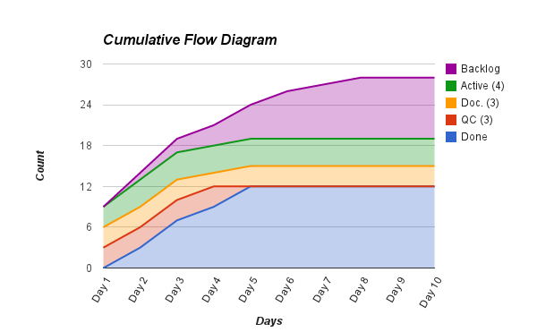
bottleneck

Slide 78
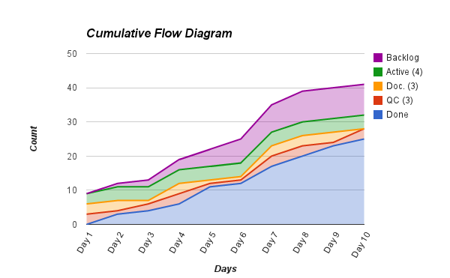
poor flow

Slide 79
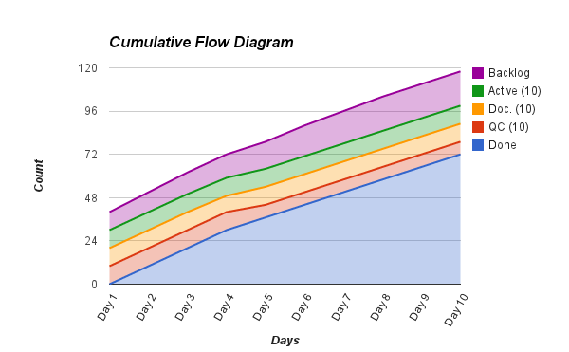
large wip

Slide 80
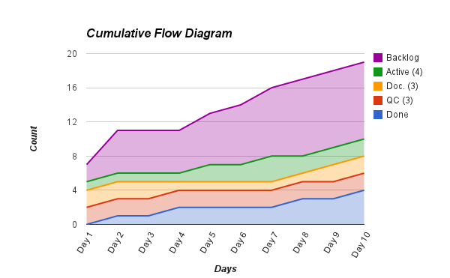
long lead time

Slide 81
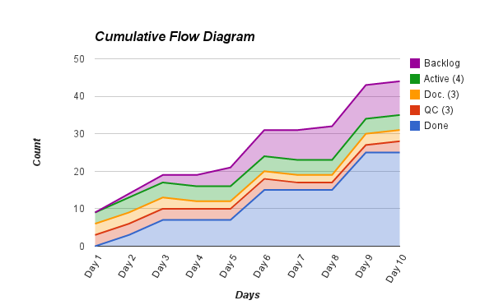
plateau

Slide 82
plot cycle time against average duration visualisation

Slide 83
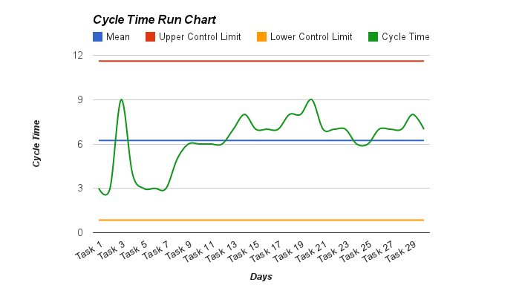
cycle time run charts

Slide 84
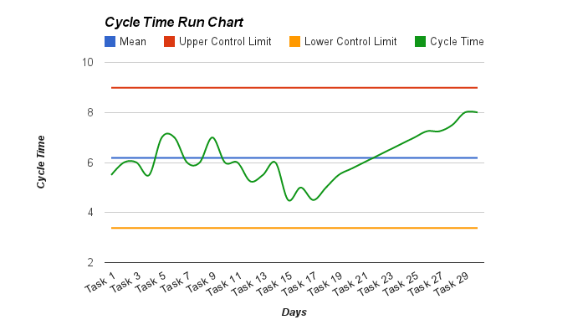
process trend

Slide 85
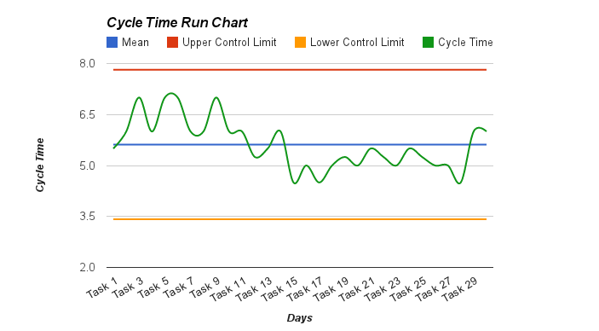
process shift

Slide 86
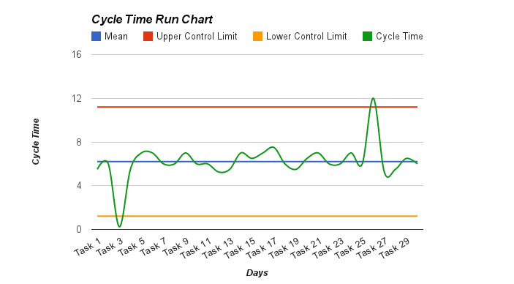
extreme process variation

Slide 87
effort visualisation plot delivered functionality against velocity

Slide 88
velocity how much work can be delivered per iteration

Slide 89
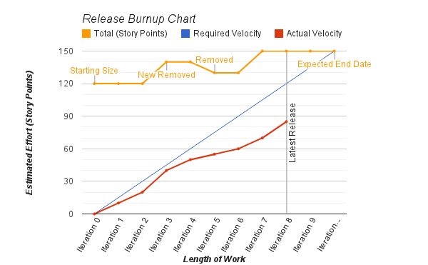
burnup chart

Slide 90
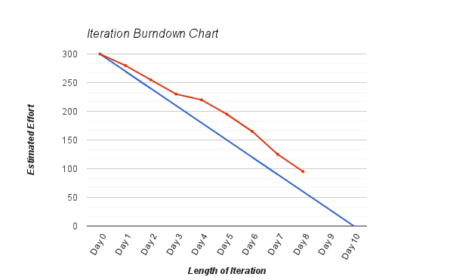
burndown chart

Slide 91
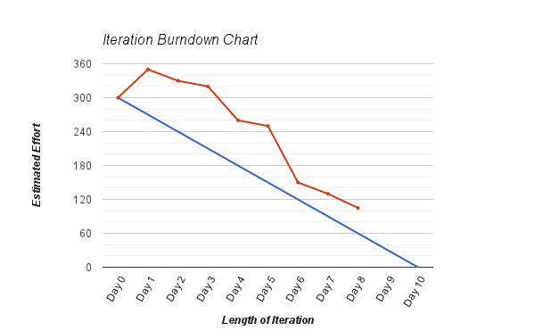
discovery

Slide 92
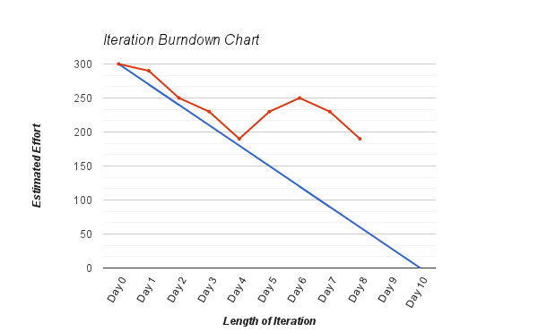
scope creep

Slide 93
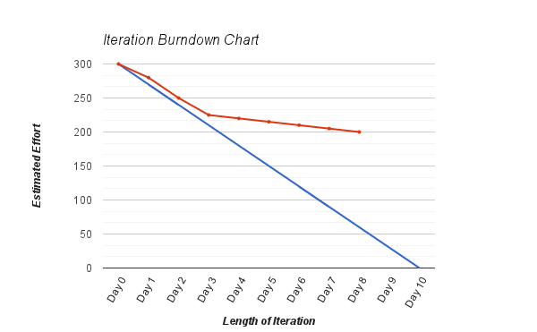
plateau

Slide 94
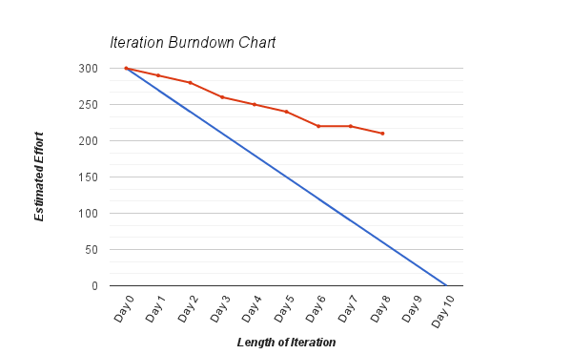
too many features

Slide 95
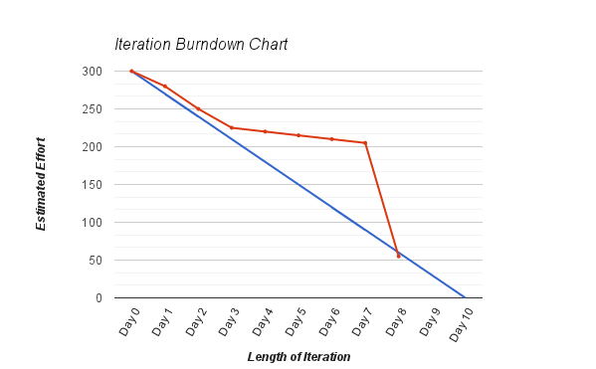
tracking epics

Slide 96
Evan Leybourn evan@theagiledirector.com questions???

Slide 97
agile business intelligence part 3: technical excellence

Slide 98
#5
Reports
#4
Metadata
#3
Data Mart
Data Mart
Data Mart
Data Mart
#2
Data Warehouse
Staging
#1
Data Source
Data Source
Data Source
Data Source
Data Source
Data Source

Slide 99
#5
Reports
#4
Metadata
#3
Data Mart
Data Mart
Data Mart
Data Mart
#2
Data Warehouse
Staging
#1
Data Source
Data Source
Data Source
Data Source
Data Source
Data Source

Slide 100
#5
Reports
#4
Metadata
#3
Data Mart
Data Mart
Data Mart
Data Mart
#2
Data Warehouse
Staging
#1
Data Source
Data Source
Data Source
Data Source
Data Source
Data Source

Slide 101
#5
Reports
#4
Metadata
#3
Data Mart
Data Mart
Data Mart
Data Mart
#2
Data Warehouse
Staging
#1
Data Source
Data Source
Data Source
Data Source
Data Source
Data Source

Slide 102
#5
Reports
#4
Metadata
#3
Data Mart
Data Mart
Data Mart
Data Mart
#2
Data Warehouse
Staging
#1
Data Source
Data Source
Data Source
Data Source
Data Source
Data Source

Slide 103
#5
Reports
#4
Metadata
#3
Data Mart
Data Mart
Data Mart
Data Mart
#2
Data Warehouse
Staging
#1
Data Source
Data Source
Data Source
Data Source
Data Source
Data Source

Slide 104
#1
#2
#3
#4
Reports
Metadata
Data Mart
Data Mart
Data Mart
Data Mart
Data Warehouse
Staging
Data Source
Data Source
Data Source
Data Source
Data Source
Data Source

Slide 105
#1
#2
#3
#4
Reports
Metadata
Data Mart
Data Mart
Data Mart
Data Mart
Data Warehouse
Staging
Data Source
Data Source
Data Source
Data Source
Data Source
Data Source

Slide 106
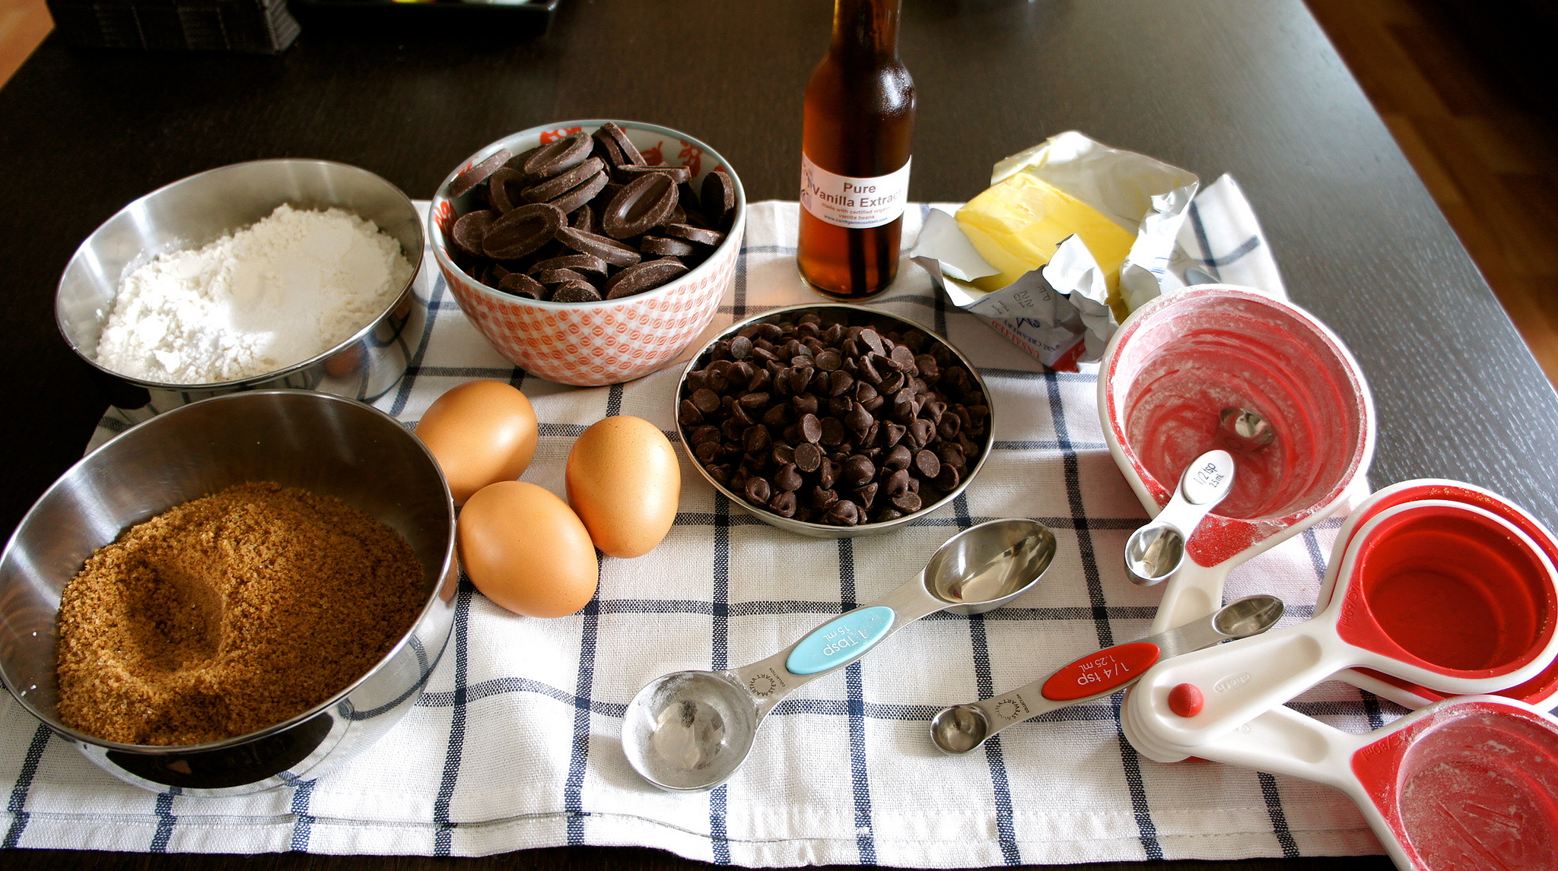
data: raw output of any database, website, log files or other data source

Slide 107

information: processed data for human usage

Slide 108
requirements reports data mart data source what is your cadence?

Slide 109
incremental data acquisition starts with strong information management

Slide 110
3 types of data data you own data you can access data you can infer

Slide 111
data sources are everywhere databases, spreadsheets, websites, documents, log files, email

Slide 112
acquisition aligns to your cadence and informs how “agile” you can be

Slide 113
Data Source | Oracle financials
What quantity of data is being dealt with? | ~10,000,000 records | How frequently does this data change? | ~0.5% per day
When does this data change? | Daily | What access is available to the data, and how can we extract it? | Direct database connection (extraction via SQL)
How much of this data is duplicated elsewhere? | Customer records in CRM (authoritative) | How much of this data is obsolete or irrelevant? | 18% - audit records older than 7 years
What reports currently use this data, and are they satisfactory? | Financial reporting, annual reporting | How is this data used? | To manage financial records
Is external or third party permission required before extracting this data, and how much will that cost? | No | Does the organisation have the skills in-house to perform the analysis and extraction? | In-house

Slide 114
incrementally build a data dictionary part of your definition of done

Slide 115
feature driven development for business intelligence

Slide 116
1. develop overall model (system)
2. build feature list (project)
3. plan by feature (iteration)
4. design by feature (iteration)
5. build by feature (iteration)

Slide 117
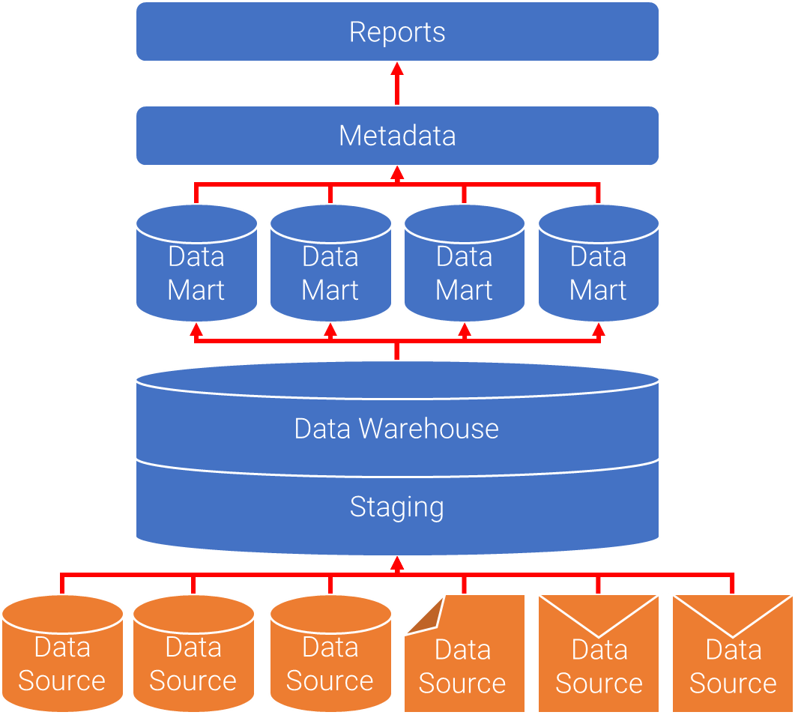
develop overall model
- high level scope
- domain walkthrough & peer review
- merge into complete system model

Slide 118
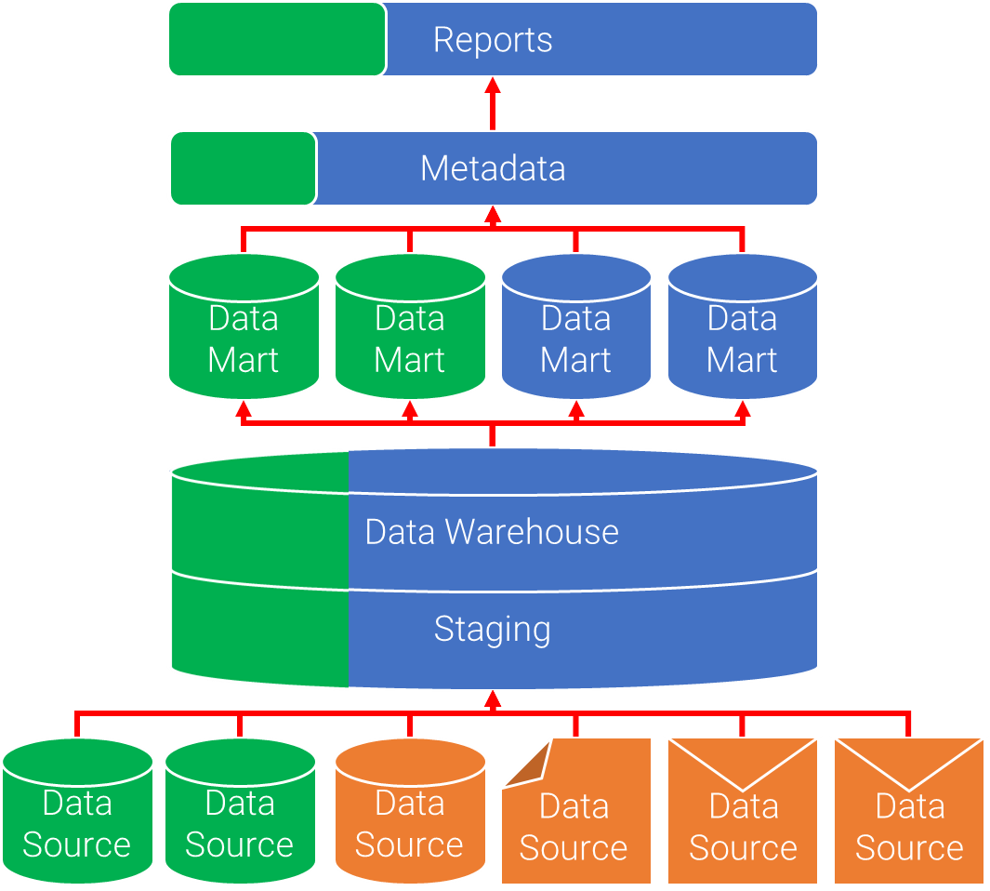
build feature list
- split domain into subject areas
- separate into business activities
- separate into individual features

Slide 119
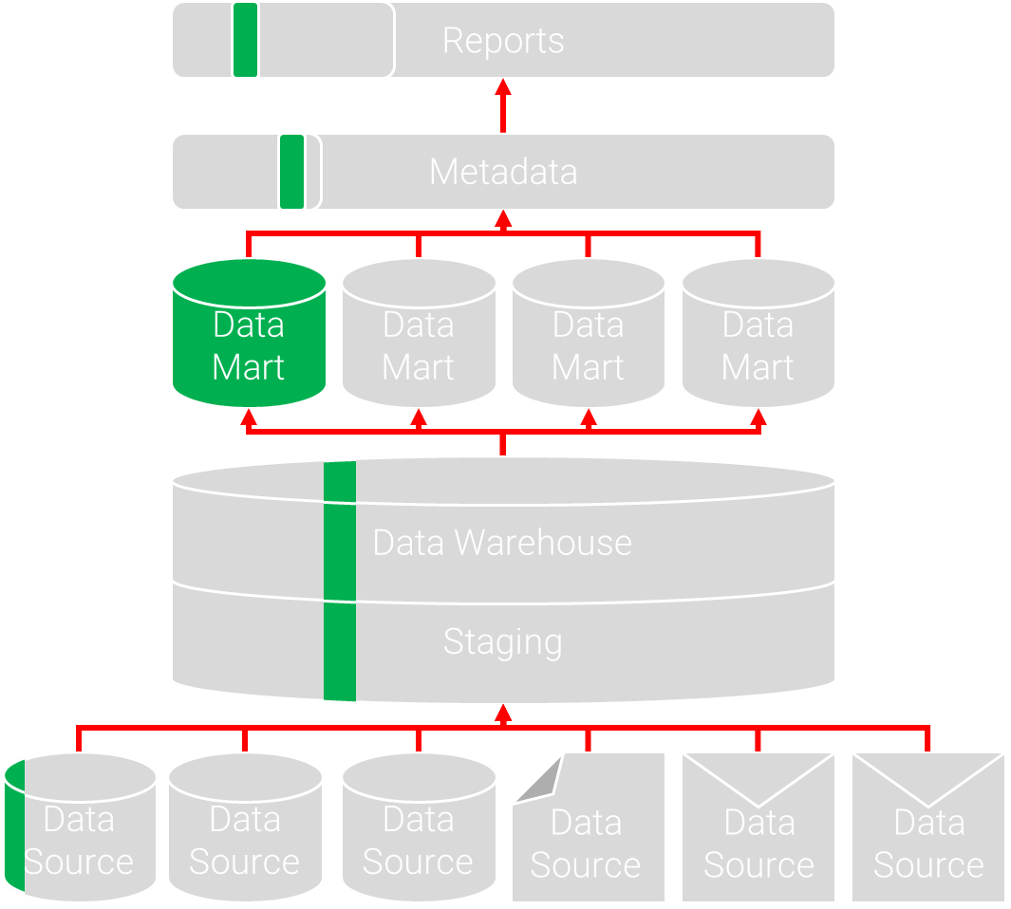
plan by feature
- assign features to data models
- assign data models to developers

Slide 120
design by feature
- select features for the iteration
- build sequence diagrams (Kanban)
- inspect and review the design

Slide 121
build by feature
- develop each feature
- unit test
- deploy feature

Slide 122
agile estimation first order estimate - using story points

Slide 123
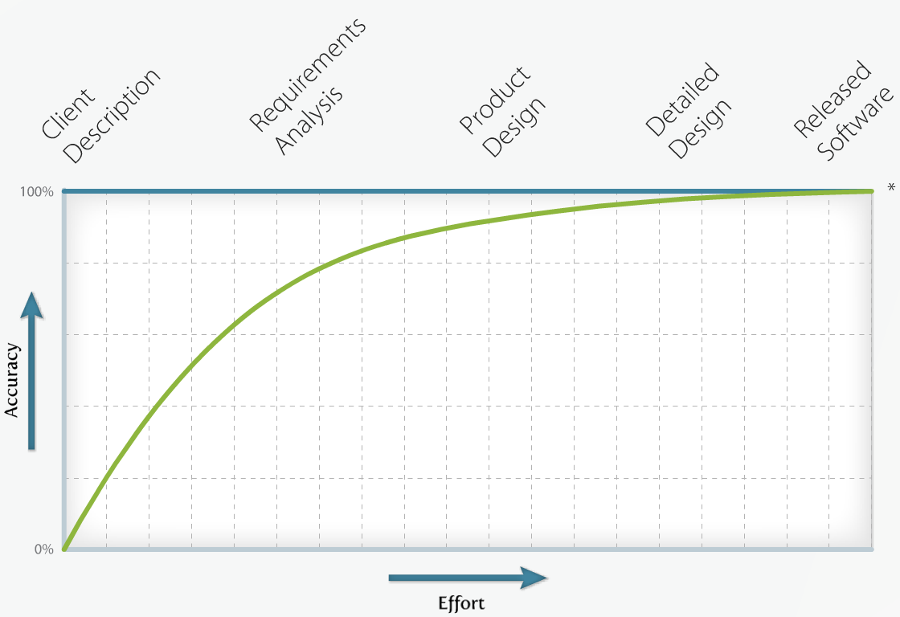

Slide 124
1, 2, 3, 5, 8, 13, 20, 40, 100 simplified fibonacci sequence

Slide 125
expert opinion the team member with specific domain knowledge e.g. dba estimating database tasks

Slide 126
comparison comparing a task to another, estimated, task e.g. task a is about twice the effort of task b

Slide 127
components break a large task into small sub-tasks e.g. break report into data mart, metadata, navigation, etc.

Slide 128
planning poker everyone plays a card representing their estimate everyone participates to reach consensus

Slide 129
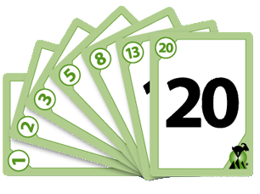
estimates must not be mentioned during planning discussion to avoid anchoring

Slide 130
staff overhead: non project time estimated leave, illness, breaks, meetings etc. generic industry modifier: 25%

Slide 131
duration calculation story cost x
(overhead + 1) x (estimate risk + 1) estimate risk is optional

Slide 132
for example
4 x (25% + 1) x (50%+ 1)
= 4 x 1.25 x 1.5
= 5 to 7.5 hours

Slide 133
plan, design & estimate tasks agile planning process

Slide 134
Select user story
Determine tasks to deliver user story
Agree technical dependencies and order
Estimate the effort required to complete each task
Assess the risks associated with the task estimate
Assign the task

Slide 135
plan, design & estimate tasks constraining principles

Slide 136

constraining principles technical develop by feature regular inspections configuration management regular builds test the system regular refactoring common code standards clear system metaphor

Slide 137
constraining principles organisational pair programming feature teams technical ownership understand the customer transparency with the customer

Slide 138
pair programming: coder + reviewer build

Slide 139
test–driven development
1
Create a test
2
Add the test to the test catalogue
3
Write the code
4
Run the tests (all of them)
5
Clean up the code as required. (Refactor)

Slide 140
test coverage functions, boundary cases, user interface & performance

Slide 141
test types defect, usability, functionality & data

Slide 142
Highest Priority Task
Test-Driven Development
Build
Commit
Continuous Integration
Done
Deploy
Testing

Slide 143
continuous build, testing & release continuous integration

Slide 144
per story or at fixed intervals deploy

Slide 145
differs by organisation what does
“done” mean?

Slide 146
definition of “done” documentation? uat? built / compiled?

Slide 147
what does
“not done” mean? the primary measure of progress

Slide 148
Evan Leybourn evan@theagiledirector.com questions???

Slide 149
agile business intelligence part 4: agile project planning

Slide 150
beginning the process agile projects have minimal initiation

Slide 151
reduce risk & uncertainty by defining the high level scope

Slide 152
align to strategic goals, & technical frameworks skills gap analysis & recruitment

Slide 153
the development team should be engaged during initiation

Slide 154
customer is fully aware of their responsibilities customers share accountability for delivery

Slide 155

- “how much is this going to cost?”
- “as much as you’re willing to spend.”

Slide 156

- “how long is this going to take?”
- “as long as is necessary.”

Slide 157

- “what am i going to get?”
- “whatever you tell us you want.”

Slide 158
work in priority order, release quickly & monitor cycle time fixed cost

Slide 159
work in priority order fixed time

Slide 160
fixed scope focus on backlog definition and estimation

Slide 161
fixed cost and time calculate total cost against cycle time

Slide 162
fixed cost and scope increase the estimate risk during initiation

Slide 163
fixed time and scope allocation additional time into the schedule

Slide 164
fixed cost, time and scope cancel the project

Slide 165
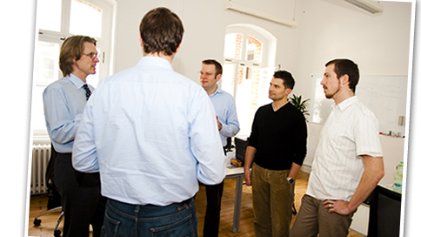
scrum
* iterative product development
* 1-4 week sprints
* formal roles (product owner & scrum master)
* timeboxed meetings

Slide 166
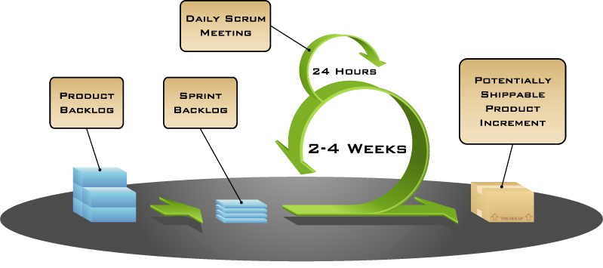

Slide 167
define user stories as a ... i need ... so i can ...

Slide 168
invest characteristics independent & self-contained

Slide 169
invest characteristics negotiable & flexible

Slide 170
invest characteristics valuable to the customer

Slide 171
invest characteristics estimatable and clearly defined

Slide 172
invest characteristics small – between ½ - 2 days

Slide 173
invest characteristics testable with defined qc metrics

Slide 174
create an ordered product backlog (in low detail) allow customers to slowly define their needs

Slide 175
High Priority
Low Priority
Summary
Estimate
Function
Detail
Acceptance Criteria
Summary
Estimate

Slide 176
inspect and adapt kaizen (改善)

Slide 177
what went well? retrospective / quality circle

Slide 178
add actionable tasks to the backlog what could be improved?

Slide 179
kaizen emphasises teamwork, discipline & morale

Slide 180
present & review completed work to the customer regular review

Slide 181
what did you do yesterday? daily stand-up

Slide 182
what will you do today? daily stand-up

Slide 183
are there any issues? daily stand-up

Slide 184
summary stand-up for large teams

Slide 185
1. do not send defective products to the subsequent process
2. the subsequent process comes to withdraw only what is needed
3. produce only the exact quantity withdrawn by the subsequent process
4. equalise, or level, the production
5. kanban is a means to fine tuning
6. stabilize and rationalize the process

Slide 186
Evan Leybourn evan@theagiledirector.com questions???
CLICK TO DISCOVER MORE

